Slide 1
Online Training Resources
Nicholas Irving
@OxNeuro
https://www.neuroscience.ox.ac.uk/

Slide 2
https://www.medsci.ox.ac.uk/study/skills-training

Slide 3
Home | Centre for Teaching and Learning (ox.ac.uk)

Slide 4
Digital Skills Courses and Resources | IT Learning Centre (ox.ac.uk)

Slide 5
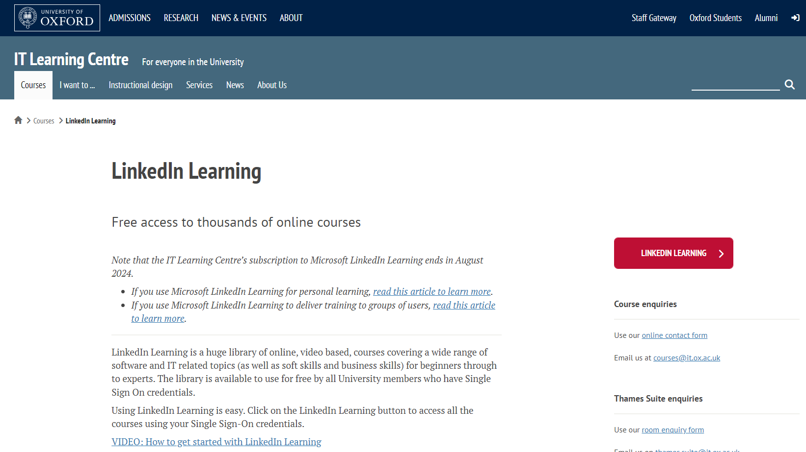
LinkedIn Learning | IT Learning Centre (ox.ac.uk)

Slide 6
https://pod.admin.ox.ac.uk/

Slide 7
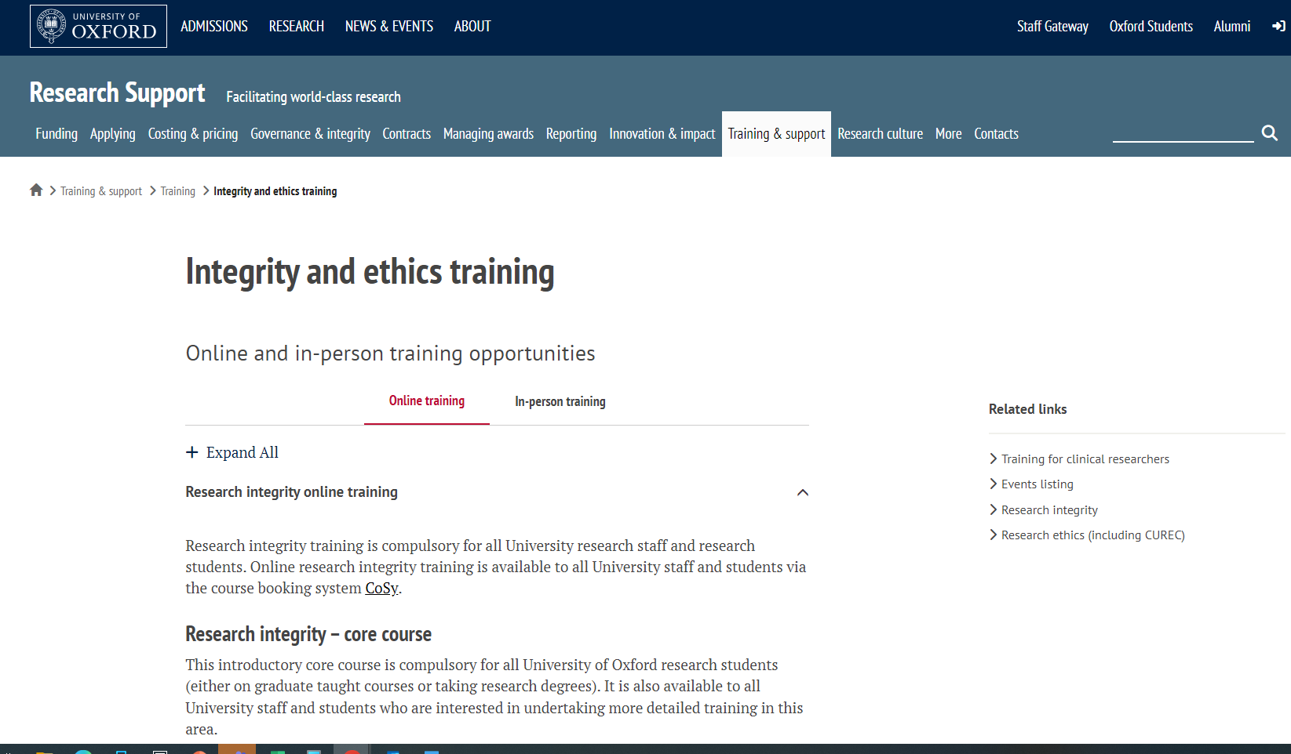
https://researchsupport.admin.ox.ac.uk/support/training/ethics

Slide 8
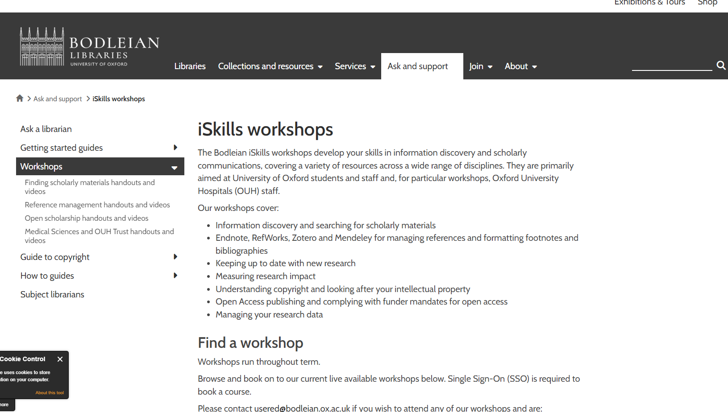
https://libguides.bodleian.ox.ac.uk/workshops

Slide 9
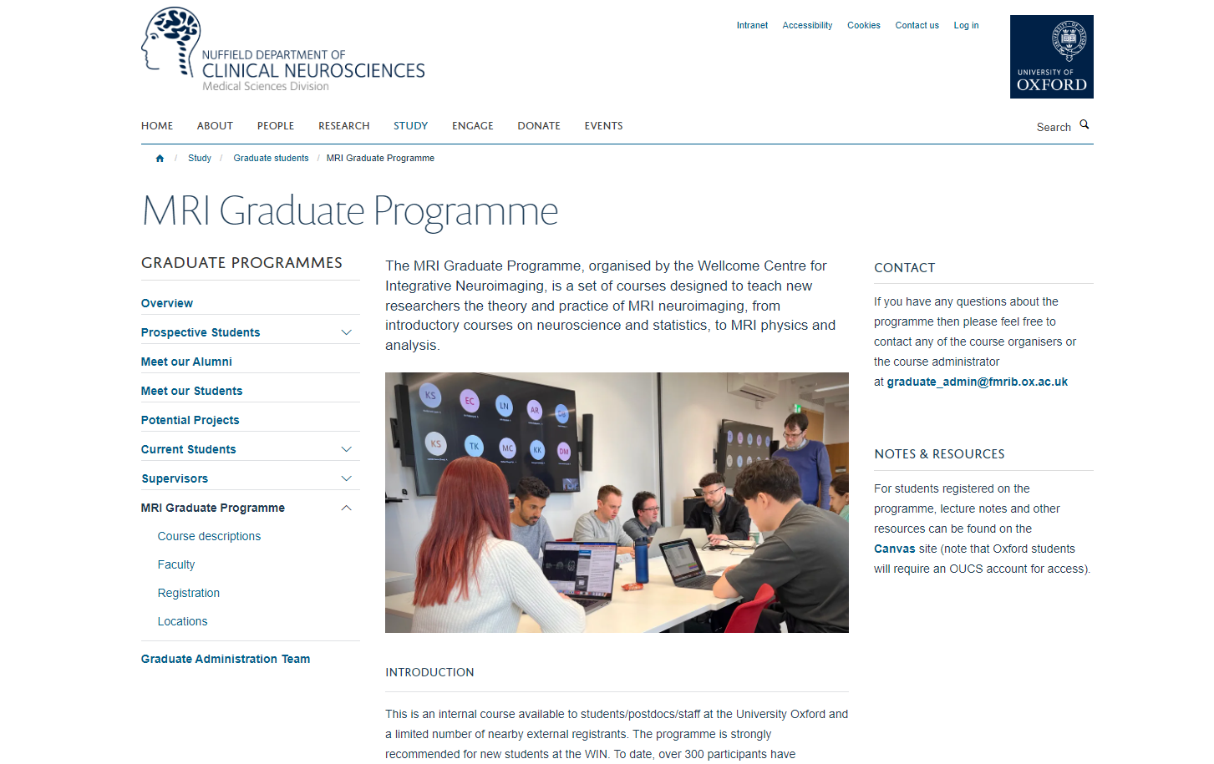
https://www.ndcn.ox.ac.uk/study/graduate-students/fmrib-graduate-programme

Slide 10
https://staff.admin.ox.ac.uk/training-and-development-providers-staff

Slide 11
That’s all folks

