Slide 1
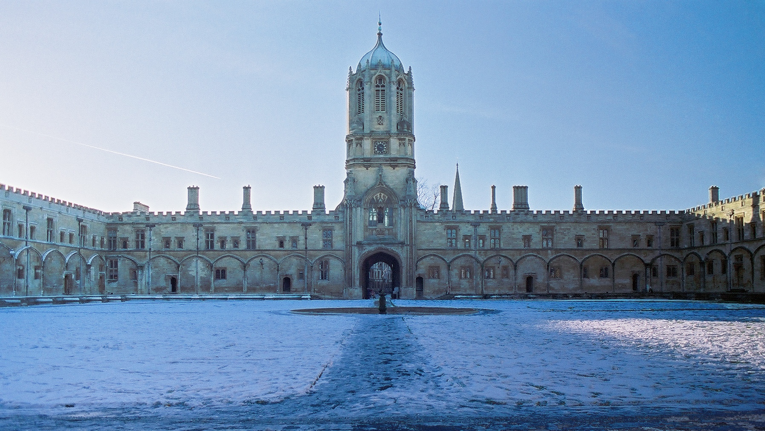
Oxford
Oldest University in the English-speaking world (founded c1096)
39 colleges (including 4 PPHs)
Reuben College founded 2019
Notes:
56 Nobel Prizes since 1904
Physics 7
Physiology/Medicine 17
Chemistry 13
Economics 9
Literature 5
Peace 5
But….
Gold medal in every Olympic Games since 1896
Heads of State of at least 16 countries (including USA)

Slide 2
Oxford
56 Nobel Prizes since 1904
Gold medal in every Olympic Games since 1896
Heads of State of at least 16 countries, including 13/16 UK PMs since 1945
Notes:
56 Nobel Prizes since 1904
Physics 7
Physiology/Medicine 17
Chemistry 13
Economics 9
Literature 5
Peace 5
But….
Gold medal in every Olympic Games since 1896
Heads of State of at least 16 countries (including USA)

Slide 3
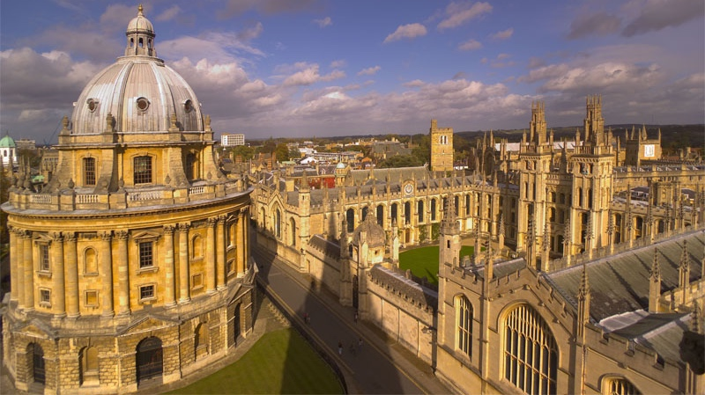
The University
4 academic divisions:
Medical Sciences
Mathematical, Physical, and Life Sciences
Humanities
Social Sciences

Slide 4
Medical Sciences
16 departments:
Pre-clinical / “down the hill” – teach undergraduates
Clinical / “up the hill” – don’t teach undergraduates
EP is a pre-clinical department, Psychiatry and NDCN are clinical departments
NDCN is made up of 6 internal divisions (e.g. WIN, DCN)

Slide 5
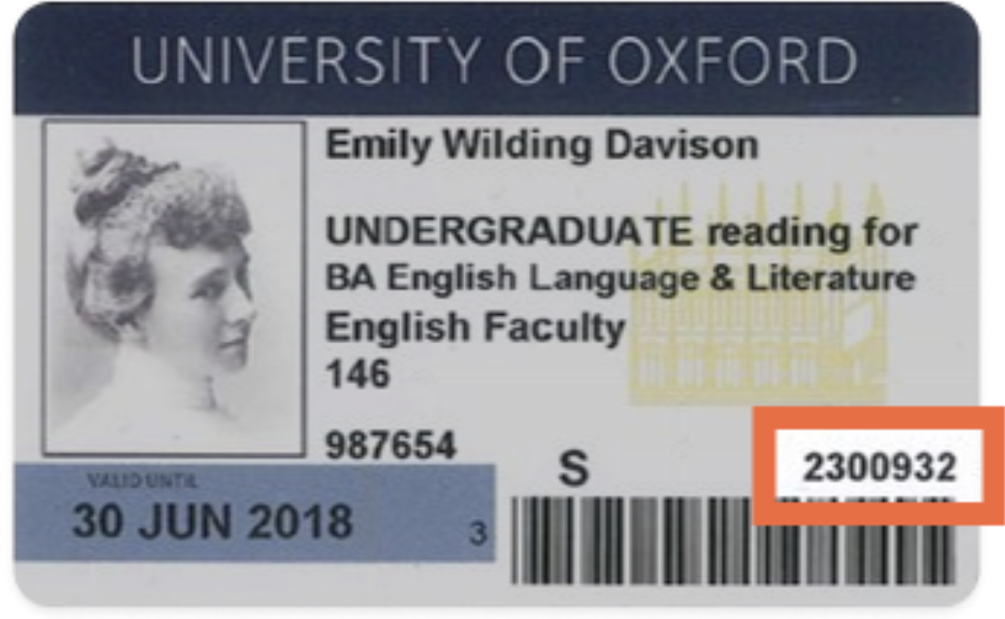
The University
4 academic divisions:
Medical Sciences
Mathematical, Physical and Life Sciences
Humanities
Social Sciences
GLAM: Gardens, Libraries And Museums of Oxford University

Slide 6
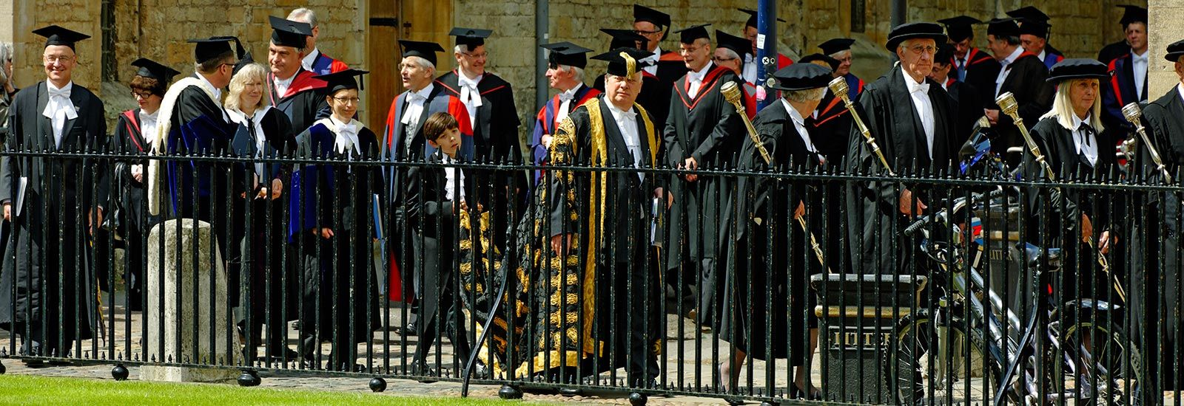
Organisation
Chancellor - Lord Patten

Slide 7
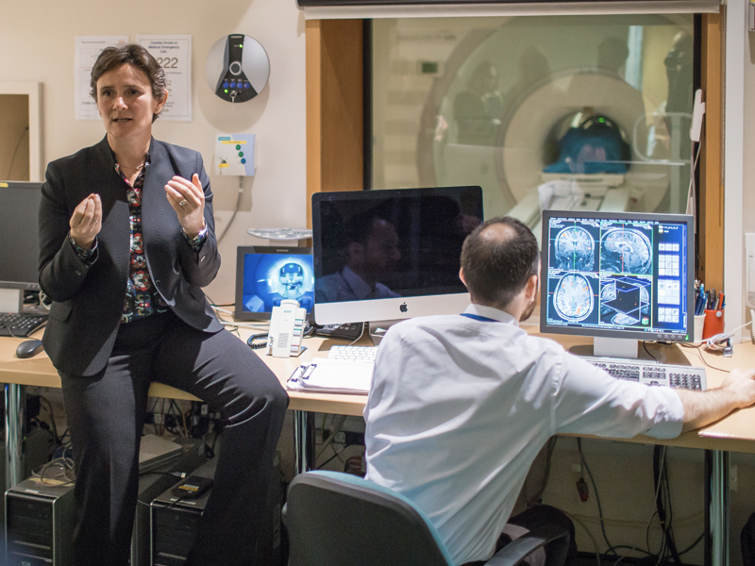
Organisation
Chancellor - Lord Patten
Vice-Chancellor – Irene Tracey
Congregation – 5000 senior academics.

Slide 8
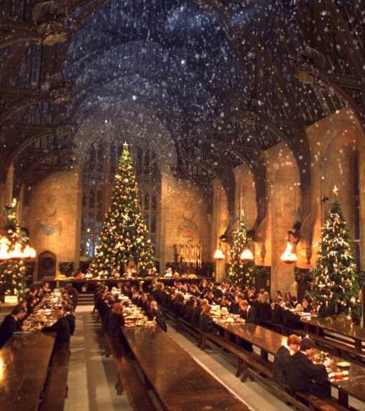
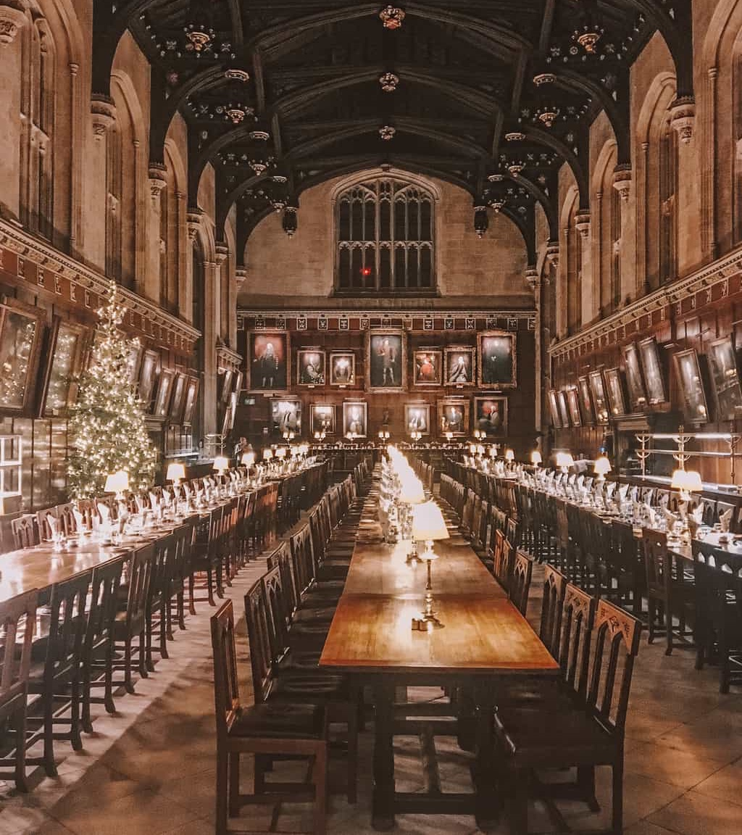

Slide 9
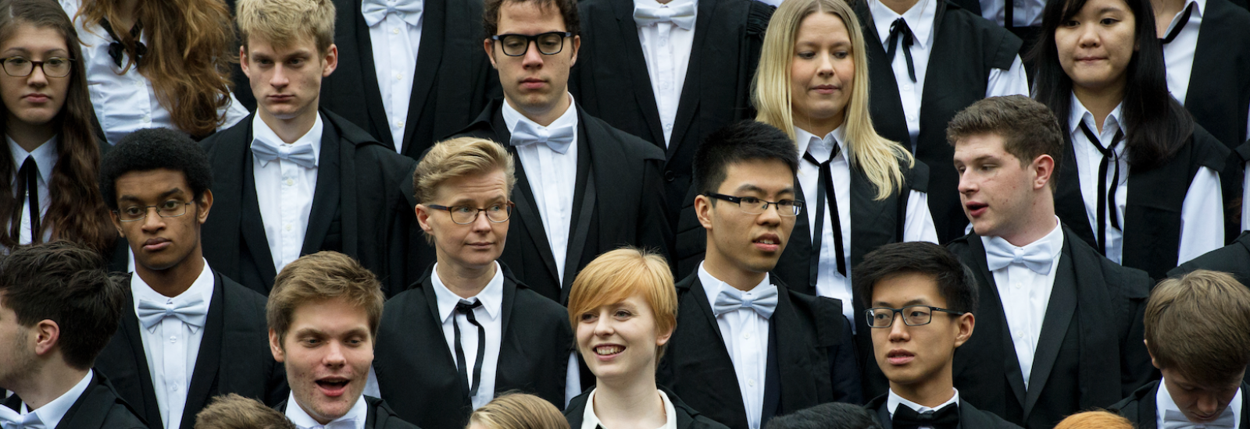
Undergraduate life
All students matriculate at the start of their course
Undergraduates read for a BA in a Final Honours School (FHS) regardless of subject
Tutorials (groups of 2-3) in college
All exams taken wearing sub fusc
Three terms: Michaelmas, Hilary and Trinity
Weeks 1-8 “full-term”, week 0, week -1.

Slide 10
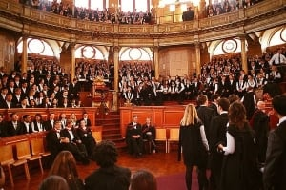
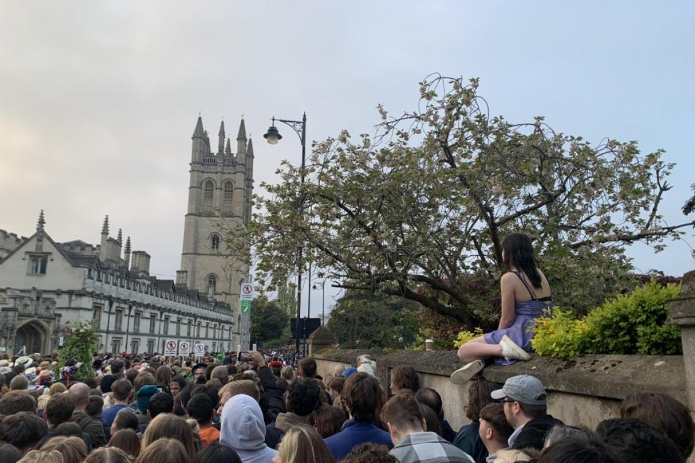
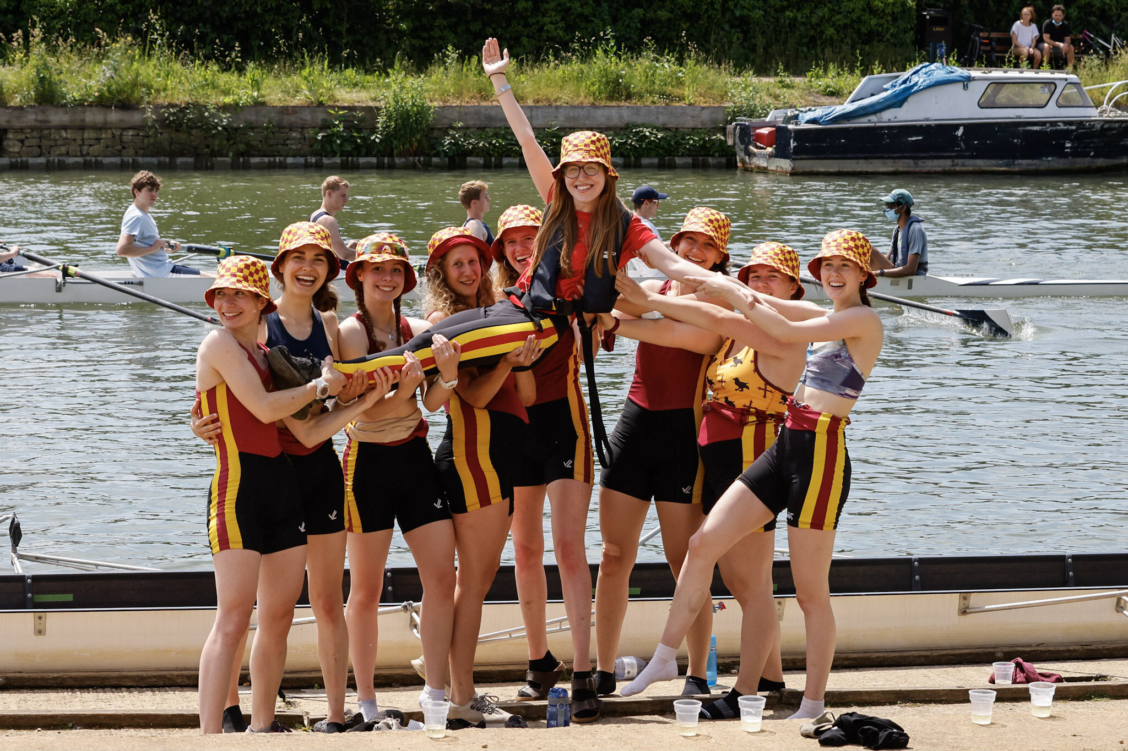

Slide 11
Enjoy!
“In spite of Keble College, and the tramways, and the sporting prints, Oxford still remains the most beautiful thing in England, and nowhere else are life and art so exquisitely blended, so perfectly made one.”
– Oscar Wilde (Magdalen College)
Charlie Stagg

Slide 12
Colleges
Departments

Slide 13
Charlie Stagg

